Slide 1

TEXT HERE
Building a Career in Data Science
PGP-DSBA

Slide 2

What is Data Science?
What is happening and why ?
What needs to be done to achieve business objectives ?
What will the future look like ?
What is the best that can happen ?

Slide 3
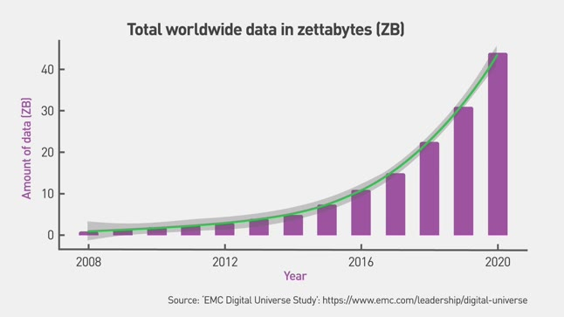
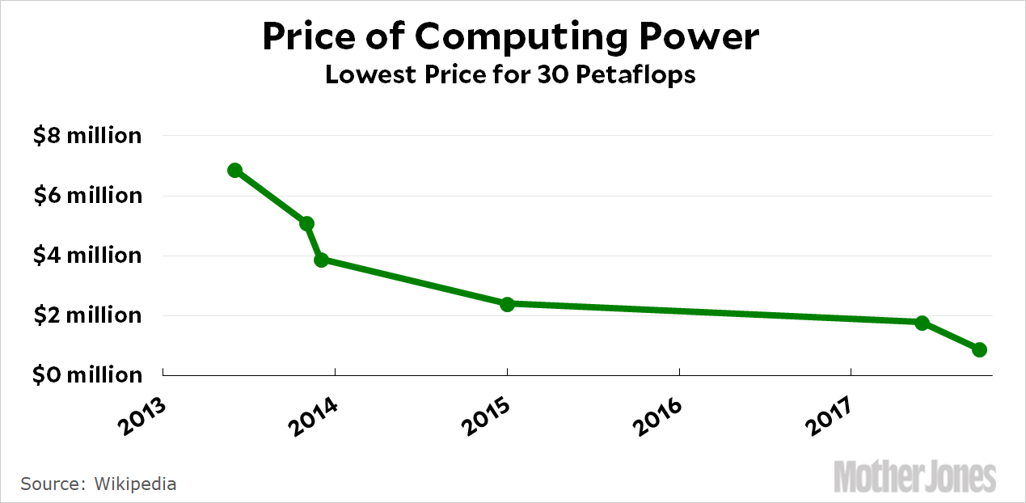
Why Data Science?
The new paradigm: Data driven decision making
Trends driving this change:
The amount of data we generate keeps increasing…
…while the cost of processing that data keeps falling!

Slide 4
Why Data Science?
92%
150 K
30%
Annual Growth Rate of DS spend
% of companies investing in DS
DS Jobs in India (2020)
$78B
97 K
DS Spend in 2021
DS Jobs in India (2019)

Slide 5

About Great Learning
Enabling career success in a digital economy
12000+
Career transitions
India’s leading ed-tech company for professional and higher education
Best in class completion rates, learner satisfaction and career transitions
2 Million Learners empowered across 160+ countries, delivered 30 million+ learning hours with an average session ratings of 4.6+ out of 5
Academic partnership with world’s leading universities
1200+
Hiring partners
30+ M
Hours of learning delivered
100+ K
Live sessions conducted

Slide 6
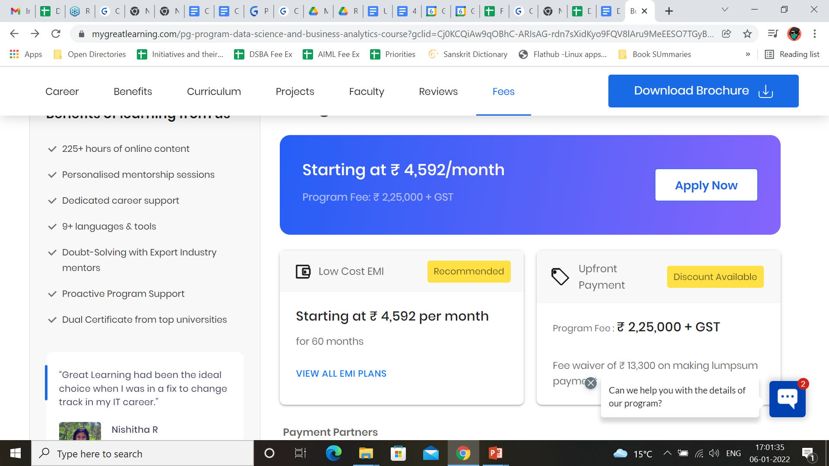
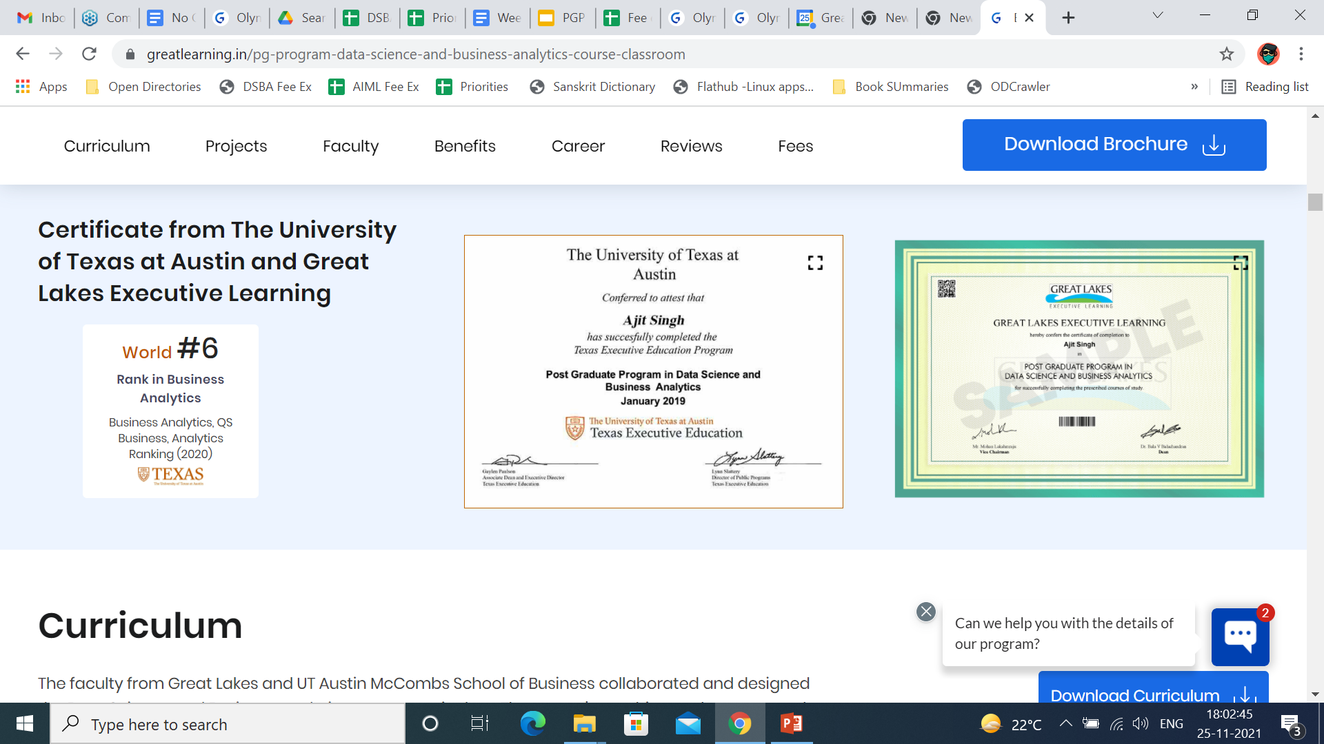
About the PGP DSBA
Program
11 month program
Flexible Structure
Great Lakes + UT Austin
Ranked No.1 program for 5 consecutive years
Peer-to-peer Learning
Immersive Experiential Hands-on learning

Slide 7
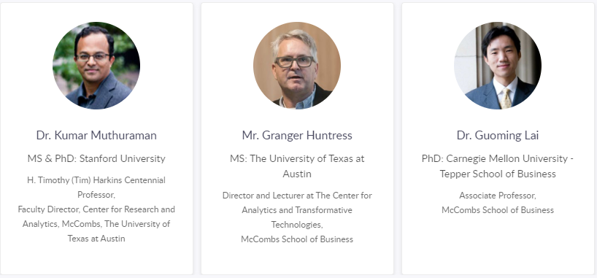
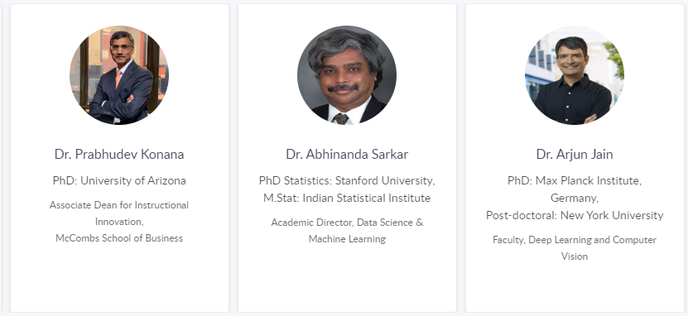
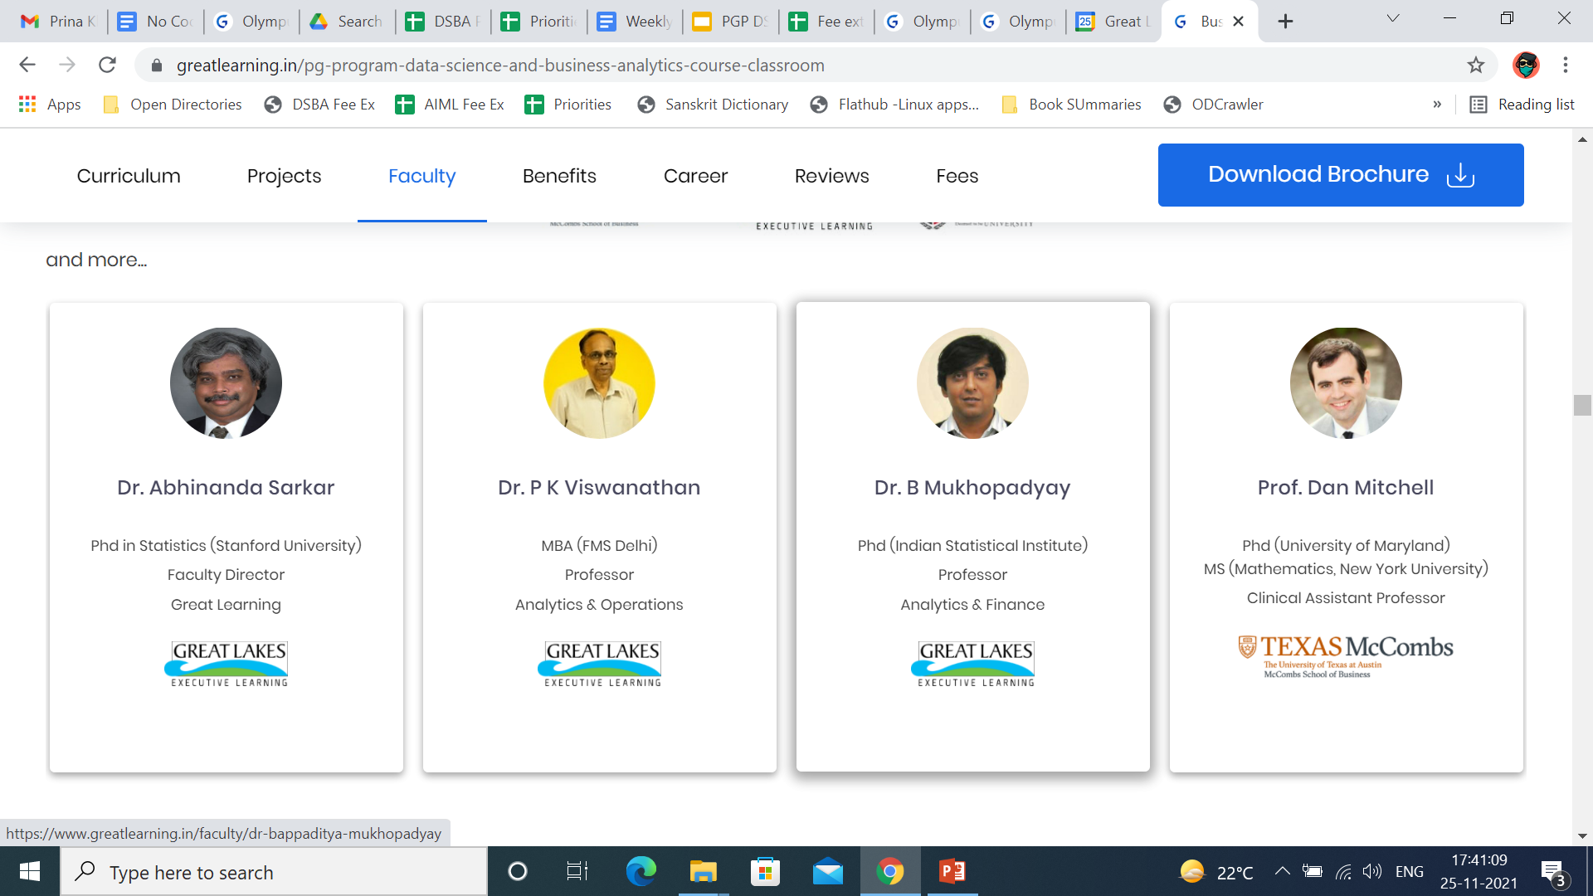
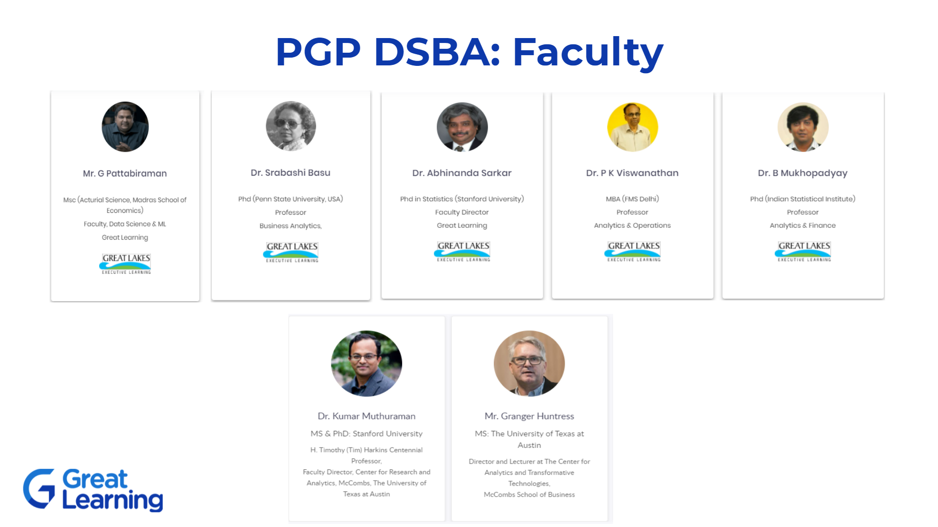
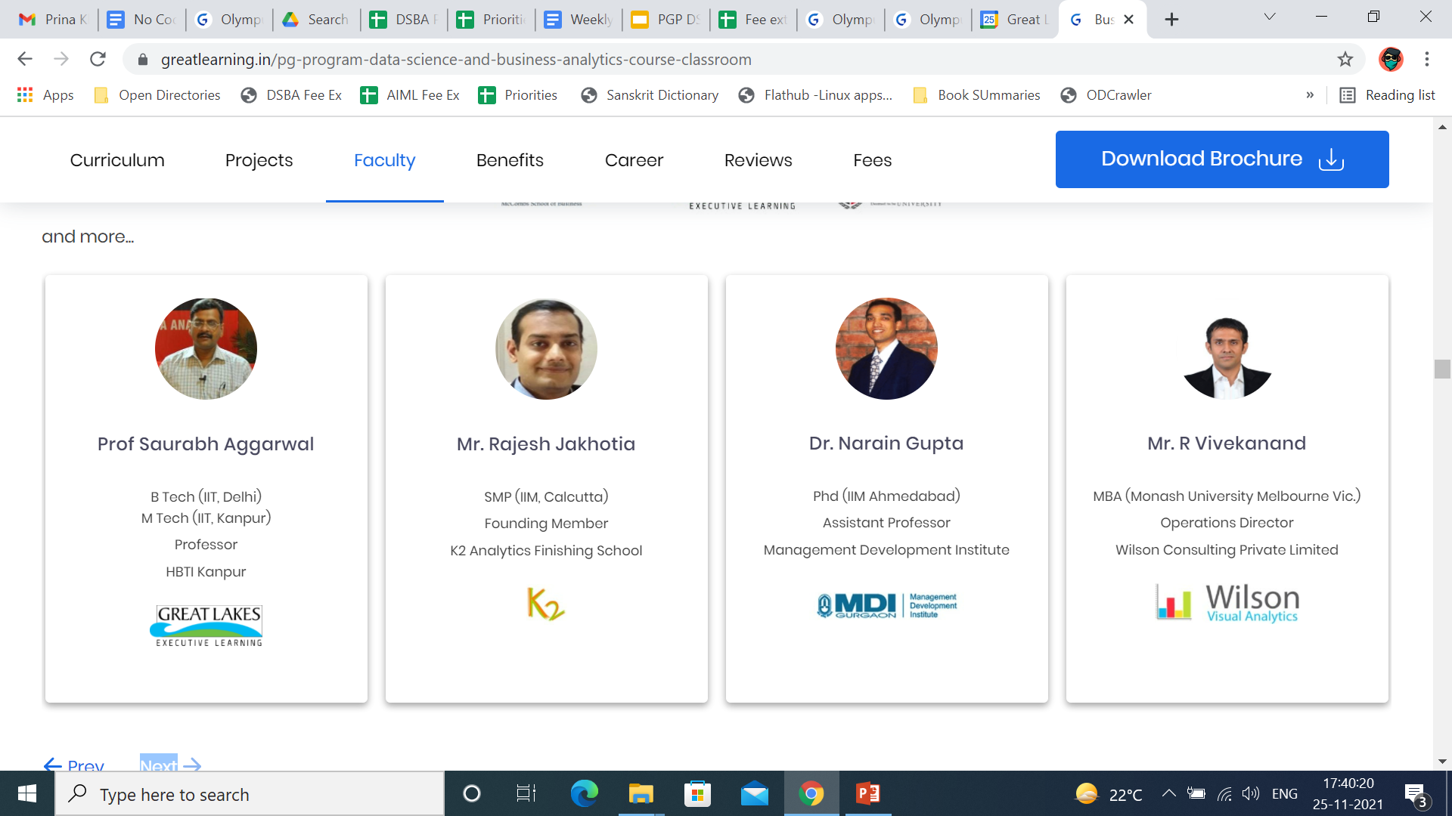
PGP DSBA: Faculty

Slide 8
PGP DSBA Curriculum
Foundation Building
Immersive Experiential Learning
Statistical Methods for decision making
Python for Data Science
SQL
Advanced Statistics
Data Science Techniques
Data Visualization
Optimization* Techniques
Capstone Project
Data Mining
Predictive Modeling
Time Series Forecasting
Machine Learning
Hackathon
Supervised learning
Unsupervised learning
Decision Trees
Neural Network
Multiple Linear Regression
Logistic Regression
Discriminant Analysis
Model Comparison
Time series analysis
Holt Winters
ARIMA
KNN & Naïve Bayes
Lasso Vs Ridge Regression
SMOTE
Bagging/ Boosting
Model Comparison
Dashboard Design
Charts
Reporting
Visual Analytics best practices
Linear Programming
Integer Programming
Goal Programming
Non Linear Programming
Case Study based projects
P2P networking
Tools
Domain Application
Python
Tableau
SQL
R*
Proof of concept
Marketing and Retail Analytics
Financial and Risk Analytics
Supply chain and* Logistics Analytics
Web and Social media* Analytics
Data Science at Work

Slide 9
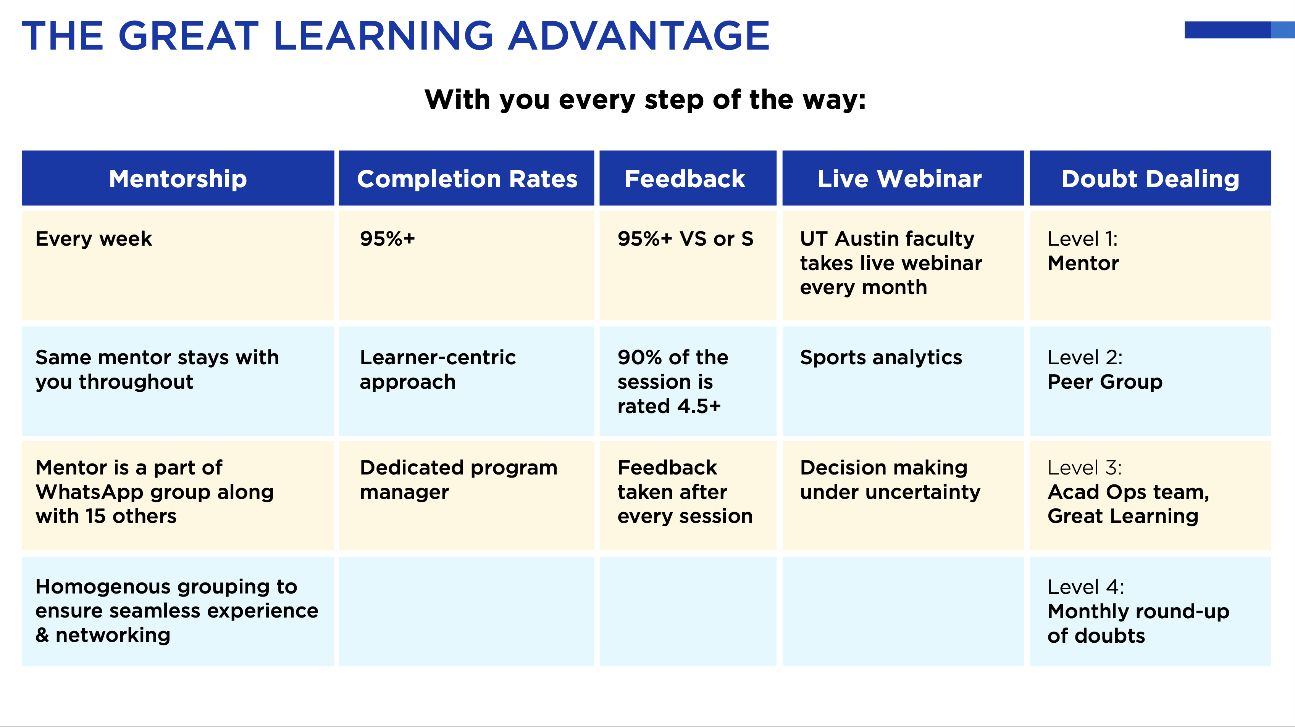

Slide 10

Capstone Project
Hands-on, application oriented
Demonstrates real world problem solving by students
Builds a body of work to show to potential recruiters
Examples include:
(Retail) Market basket analysis for consumer durables
(Supply Chain): Demand forecasting model
(E commerce): Customer engagement and brand perception
(Banking): Credit default projection

Slide 11

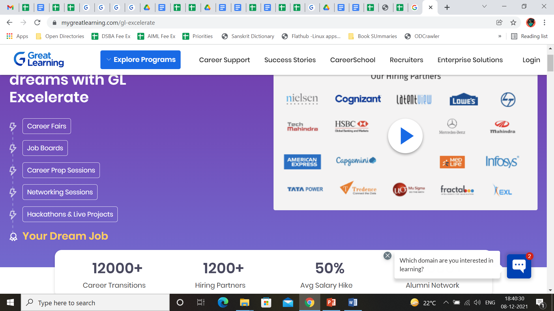
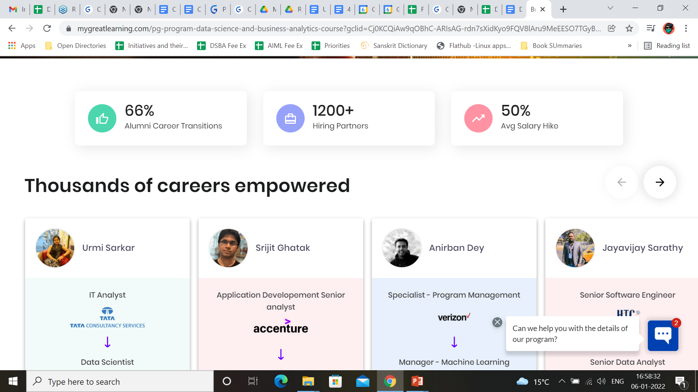
Career Services: GL Excelerate

Slide 12
Contact Us:
Phone: +91 80 4718 9251
Email: pgpdsba@greatlearning.in
Program website:
https://www.greatlearning.in/pg-program-data-science-and-business-analytics-course-classroom

